Slide 1
Spring Boot
Breakout: Coding the one-to-many relationship in JPA

Slide 2
What's in this video...
Relational ownership
The difference between a unidirectional one-to-many relationship and a bidirectional one-to-many relationship
Coding a unidirectional one-to-many relationship
Coding a bidirectional one-to-many relationship

Slide 3
Relational Ownership
This is a JPA concept, not a RDBMS concept
This is how JPA keeps the various field definitions straight
In a one-to-many relationship, the parent typically "owns" the relationship
In a many-to-many relationship, pick the one that makes the most sense to you (i.e., recipe "owns" category)

Slide 4
Relational Ownership
Ownership becomes important when we look at the @JoinTable annotation
@JoinTable(
joinColumns = owner_column,
inverseJoinColumns = owned_column
)
The joinColumns attribute must name the table column (NOT Java field name!) in the owning table
The inverseJoinColumns attribute must name the table column in the owned table

Slide 5
Unidirectional vs. bidirectional one-to-many
Unidirectional: parent knows about child; child does not know about parent
Bidirectional: parent knows about child; child knows about parent
Indicated by:
The presence or absence of the parent entity in the child
The presence or absence of the mappedBy attribute in the OneToMany annotation

Slide 6
Bidirectional one-to-many
@Entity
class Parent {
@OneToMany(mappedBy = "parent")
Set<Child> children = new
HashSet<>();
}
@Entity
class Child {
@ManyToOne
Parent parent;
}

Slide 7
Unidirectional one-to-many
@Entity
class Parent {
@OneToMany(mappedBy = ??)
Set<Child> children = new
HashSet<>();
}
@Entity
class Child {
// No variable of type Parent
}

Slide 8
Unidirectional one-to-many
Spring JPA creates a join table to map from parent to child
parent_id | child_id
1 | 1
1 | 2
2 | 3
The join table name and column names can be specified with an @JoinTable annotation

Slide 9
@JoinTable annotation
@JoinTable(
name = "join_table_name",
joinColumns =
@JoinColumn("owner_column"),
inverseJoinColumns =
@JoinColumn("owned_column")
)
If you don't specify the @JoinTable annotation, JPA will create one with default names

Slide 10
What are we coding in this video project?
Both projects use the same tables
A bunny breed and description schema

Slide 11
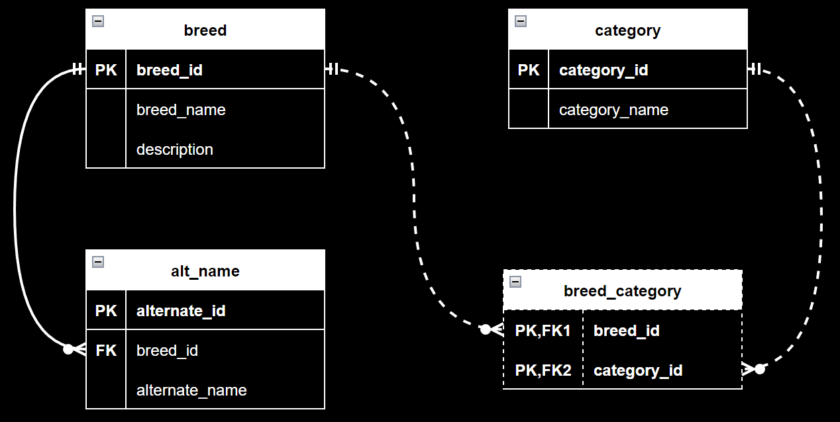

Slide 12
Let's code it!

